Slide 1

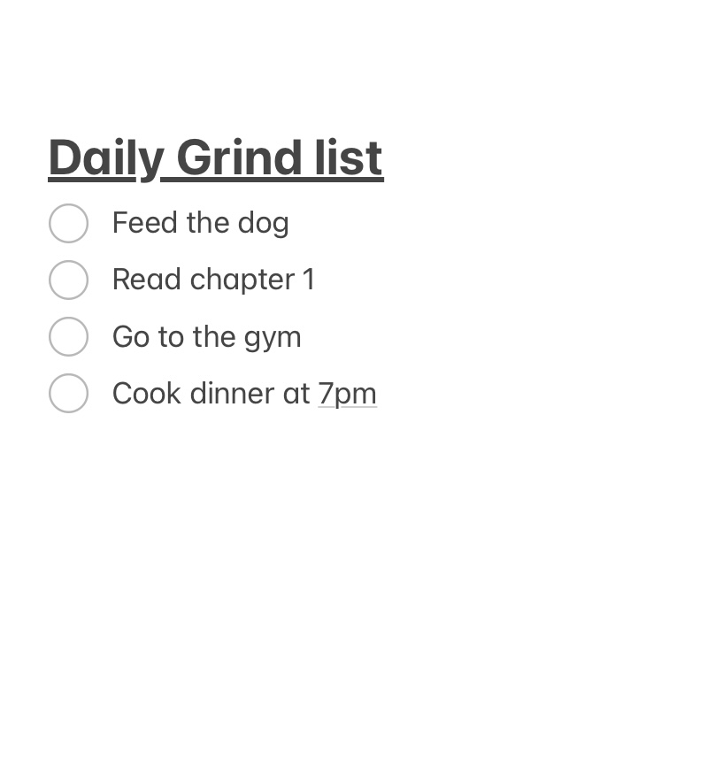
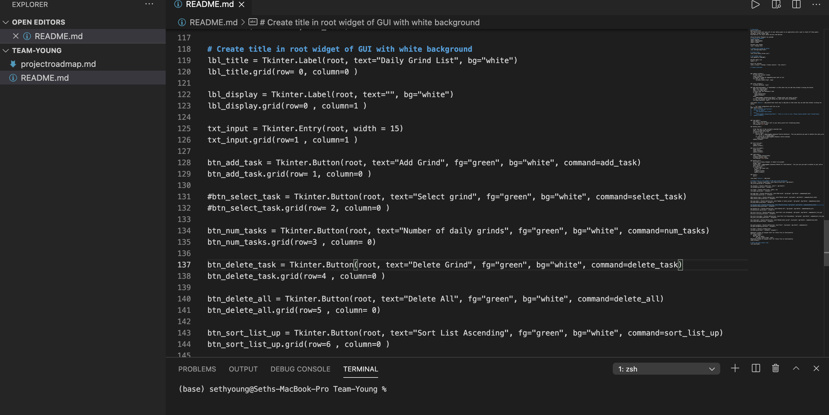
Daily Grind List
The Daily Grind List will provide the user with the ability to write down different tasks they would like to complete. The user will also be able to check off boxes when they have completed each task.
Seth Young

